Slide 1
SmartEd Solutions
Husna Iqbal

Slide 2

Our Services
Our Mission
Support all students
Offer programs for various exams and student demographics
Decrease barriers of education and success for underrepresented groups

Slide 3
Why is this Our Mission?

Slide 4
Top Drivers for Student Success
Parent’s Level of Education
Completion of a Test Prep Couse
Notes:
Parent’s level of education is never in a students control. However, the completion of a test prep course is IF it is affordable.

Slide 5



Other Drivers for Student Success
Free or Reduced lunch
Race
gender
Notes:
These are some other drivers and are clearly attributed a student is unable to control

Slide 6
Where did this Data come from?
Data was given by several standardized testing agencies primarily the ACT, SAT and other state standardized testing that occurs throughout elementary and middle school.

Slide 7
How do we define Success?

Slide 8
A Successful Student
Reading, Writing, and Math score greater than 75%
Only 18.8% of students fall into this category

Slide 9
How were we able to predict a successful student?
Using a Random Forest Model!

Slide 10
What is a Random Forest Model?
Have data
Trees make decisions on random subsets of data
Trees vote in their decision
Majority wins
Final Prediction

Slide 11
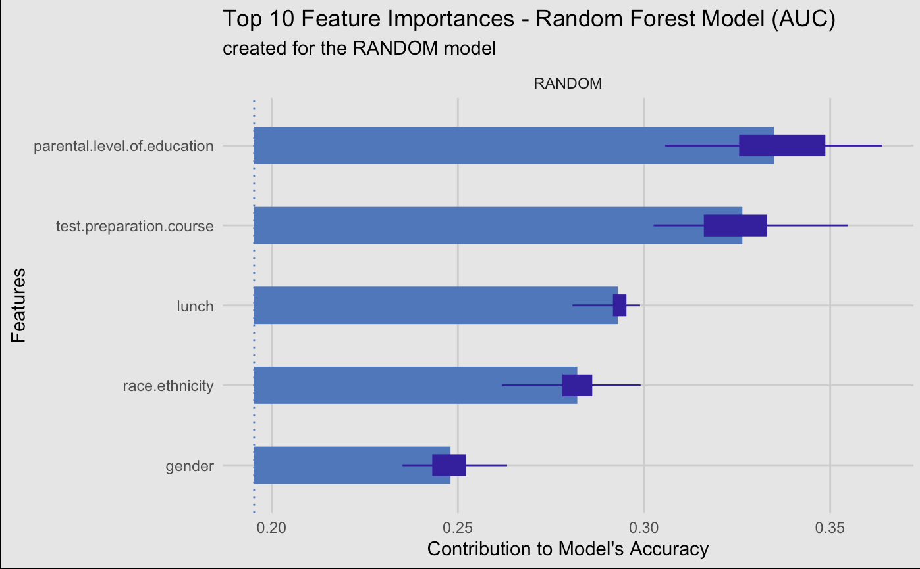
Assessing Drivers of Student Success
Student Attributes Most Related to Success
Parent’s Level of Education
Prep Course Completion
Free / Reduced Lunch
Race / Ethnicity
Gender
20%
25%
30%
35%
Contribution to Predicting Success

Slide 12
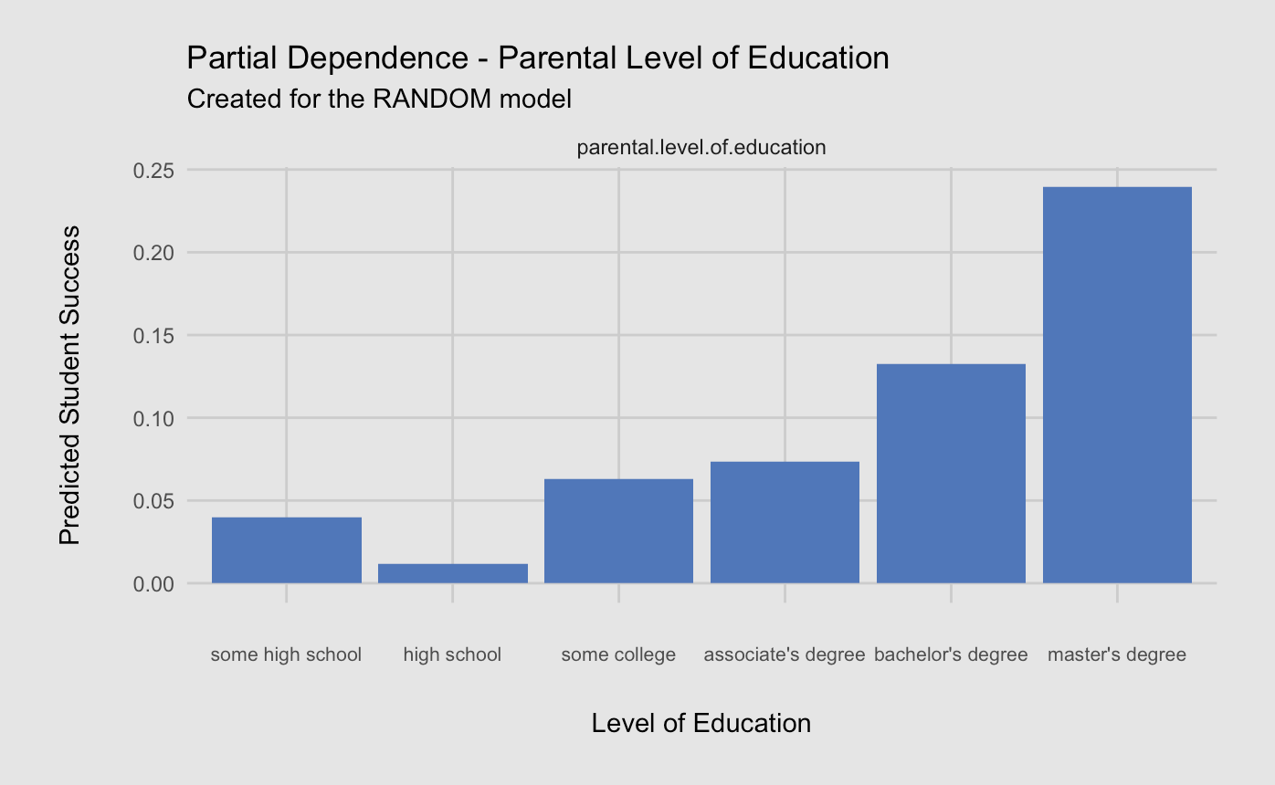
Assessing Parent’s Level of Education
Students whose parents hold a master’s degree have the highest chance of success!
Parent’s Level of Education and Student Success
25%
20%
15%
10%
5%
0%

Slide 13
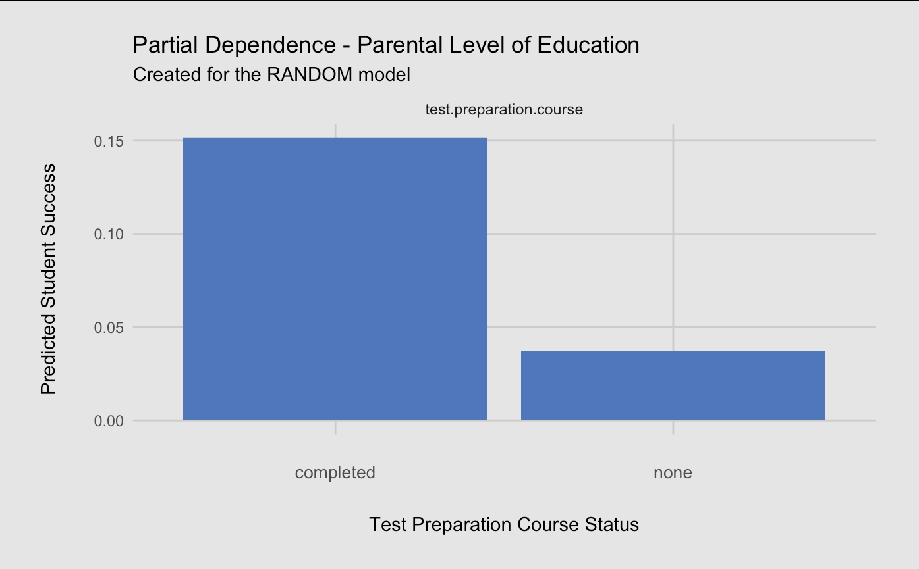
Assessing Test Prep Course Completion
Test Prep Course Completion and Student Success
Completing a test preparation course more than triples the chance for student success!
15%
10%
5%
0%
Notes:
Test course completion plays a significant weight in student success. However, completion of a course may be difficult if it is costly or requires supplemental tutoring and help from the parent at home which the student does not have access to.

Slide 14
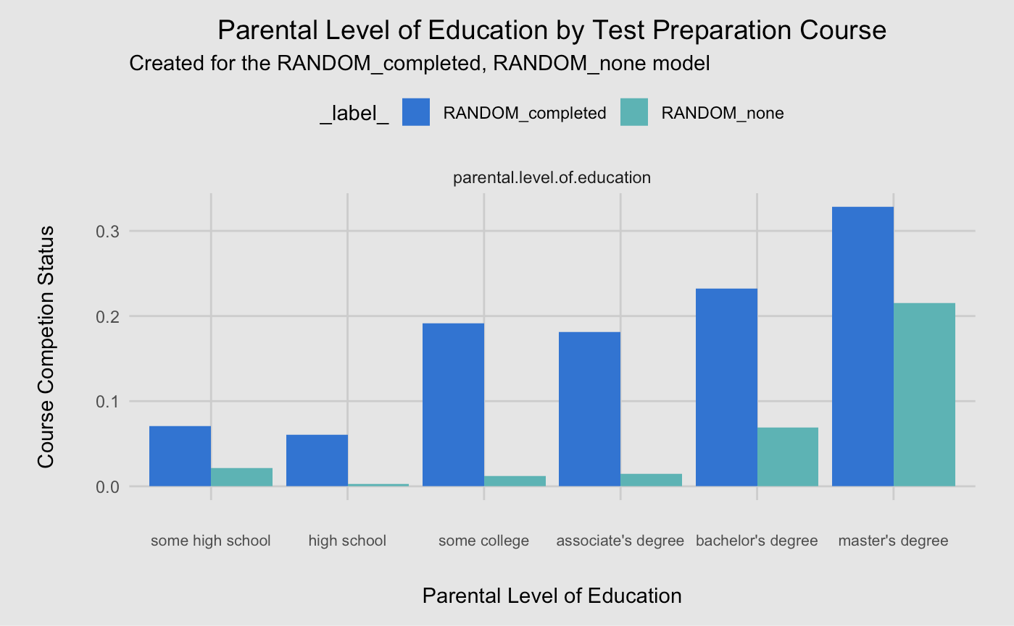


Prep Course Completion by Parent’s Education
A lower level of parental education reduces the likelihood of a student's success.
Prep Course Completion by Parent’s Education
30%
20%
Predicted Student Success
10%
Completed
Did not complete
0%
Notes:
Typically, lower levels of education is associated with lower socioeconomic status which may be the reason for th elack of prep course completion if cost was a barrier…

Slide 15
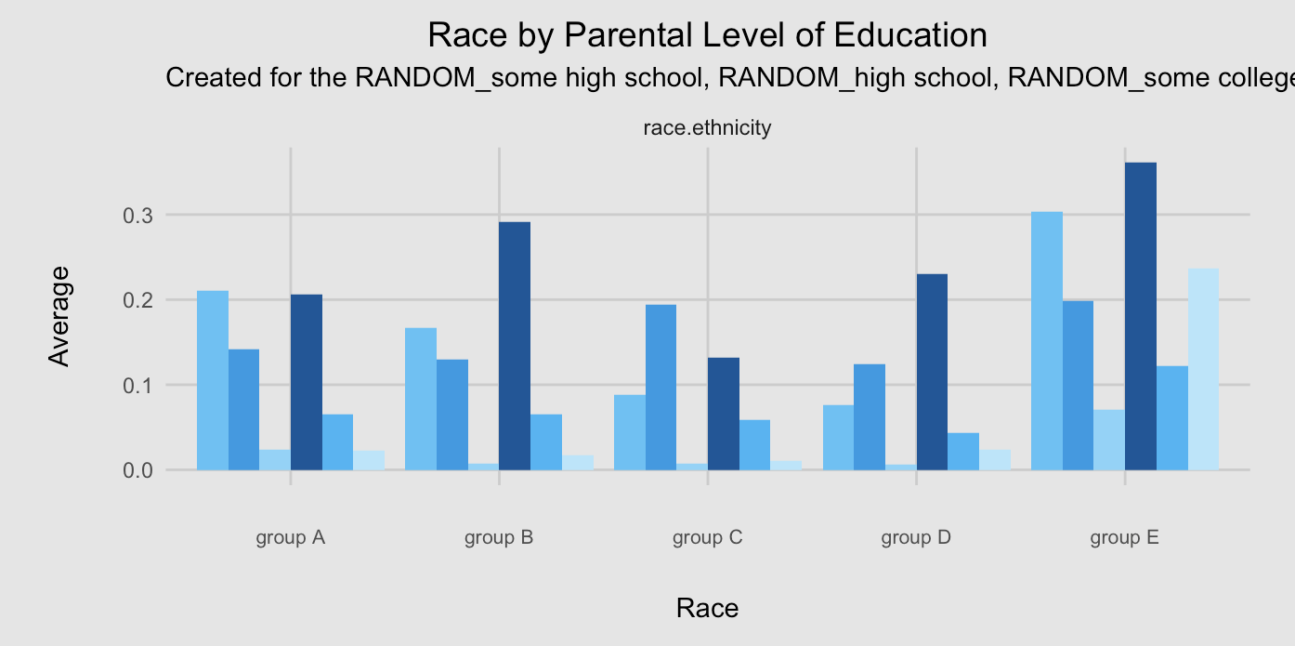






Parent’s Level of Education by Race
Parent’s Education by Race
30%
20%
Some high school
Predicted Student Success
High School
10%
Some college
0%
Associate’s degree
Bachelor’s degree
Master’s degree
Notes:
See if there are any differences based upon race when it comes to parent’s education – group D seems to have the lowest predictions of success with all education levels

Slide 16
Are there certain combinations that lead to the higher or lower success?

Slide 17
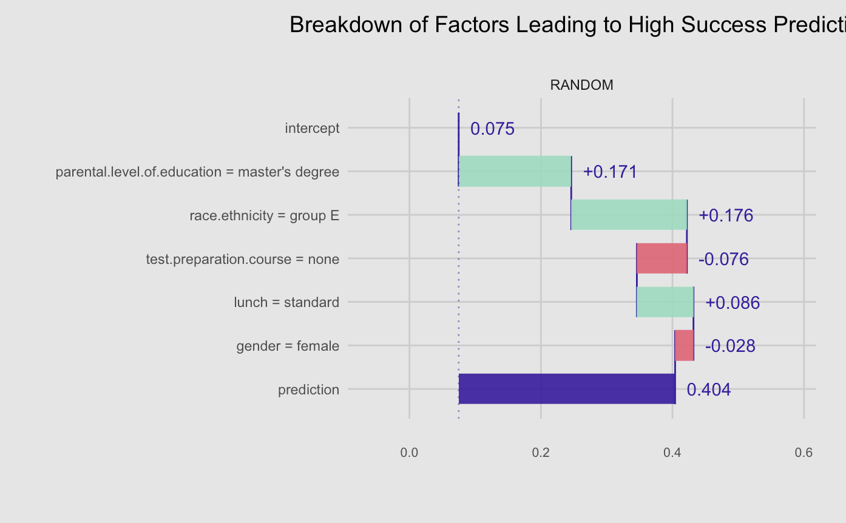
Factors that lead to High Success Predictions
Breakdown of Factors that lead to High Success Predictions
Race is the highest contributor here!
Intercept
+7.5%
Parent’s Level of Education = Master’s Degree
+17.1%
Race = Group E
+17.6%
Prep Course Completion = Not Completed
-7.6%
Free / Reduced Lunch = No
+8.6%
Gender = Female
-2.8%
Prediction
40.4%
0%
20%
40%
60%
Notes:
Explain how this plot works

Slide 18
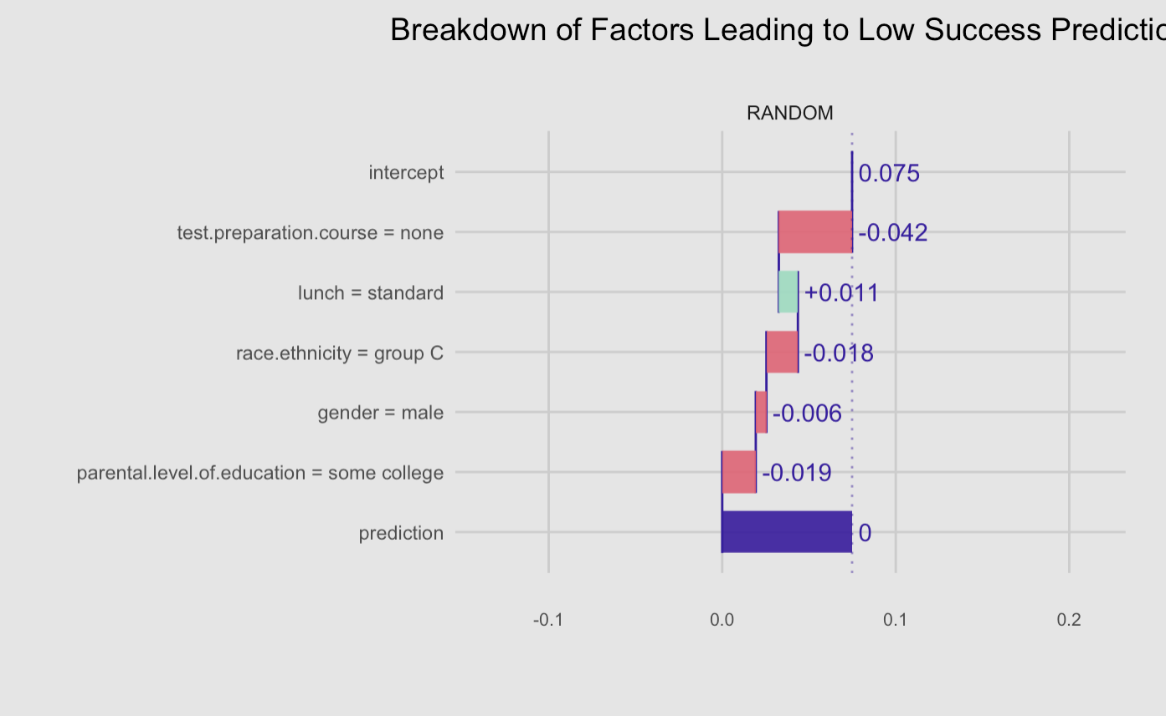
Factors that lead to Low Success Predictions
Breakdown of Factors that lead to High Success Predictions
Prep Course Completion is the highest contributor here!
Intercept
+7.5%
Prep Course Completion = Not Completed
-4.2%
Free / Reduced Lunch = No
+1.1%
Race / Ethnicity = Group C
-1.8%
Gender = Male
-0.6%
Parent’s Level of Education = Some college
-1.9%
Prediction
0%
0%
20%
40%
60%

Slide 19
Takeaways
Lower levels of parental education leads to lower predictions of student success
Lack of prep course completion leads to lower predictions of student success
Certain combinations of attributes have the highest / lowest predicted success

Slide 20
What can we do with all this information?

Slide 21
Solutions
Offer free test preparation course for students who qualify based on their parent’s level of education and socioeconomic status
Ensure supplemental support during test preparation course exists and is accessible (able to access via Zoom)
Tailor course to students based on their demographics schedule to ensure thorough completion

Slide 22
Questions?

